Slide 1
Q1. Using examples, suggest why managed retreat is a controversial option (10)

Slide 4
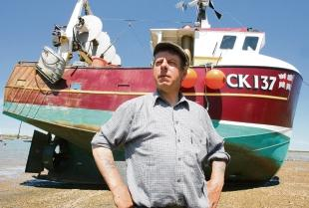
Stakeholders
West Mersea Fishermen concerned about damage to Oyster beds. Sediment levels will increase and changes in water levels may kill off Oysters and damage their habitats
Increased erosion and flooding of a site opposite the farm. Threatens bird habitats and populations

Slide 5
http://www.marinet.org.uk/campaign-article/mankinds-faltering-efforts-to-protect-coastal-idylls-from-raging-waves

