Slide 1
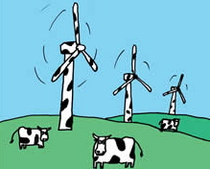
Unit 3 Resources:
Wind Farm
Investigation
Objective
To describe the costs and benefits of wind power
To contrast and compare a range of different opinions concerning wind power
To evaluate a range of possible locations for a Cumbrian Wind Farm
To identify and justify site selection for a Cumbrian Wind Farm
Task:
You must produce an A3 Newspaper report outlining your findings
To be completed using a computer (eg Word/Powerpoint/Page plus)
The newspaper article must meet the objectives above and explain:
Why does Britain need windpower?
How and why do people’s opinions concerning wind power differ?
Where are the best/worst places for wind farms and why?
Peer/student/teacher Assessment
What did you enjoy most doing this work? What was most challenging? | Now that your work has been marked what do you think you could have improved on?
What do you like most about this piece of work? | Teacher comments

