Slide 1
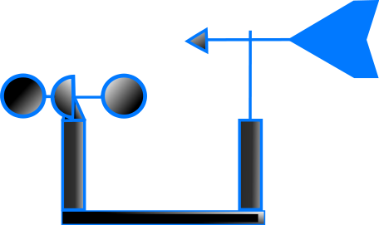
Unit 3 Weather and Climate – Weather Station project
Objective
To identify key elements of the weather
To design a series of instruments to measure the weather
To describe and explain changes in the weather over a 7 day period
Task
1.To construct a basic weather station you need:- an instrument to measure temperature
an instrument to show wind direction
an instrument to measure rainfall
a measurement for cloud cover
2.Design a results table to fill the date you collect for a week from your weather station.
3.Ensure you include a photo of your creation.
4.Complete and evaluation of your design, both positive and negative .This should be no more than one side of A4. You should consider the location of your weather station.
TIP Use the internet to find out how to build your weather station, ask your parents for help.
Peer/Self assessment
What did you enjoy most doing this work? What was most challenging? | Now that your work has been marked what do you think you could have improved on?
What do you like most about this piece of work? | Teacher comments

Slide 2
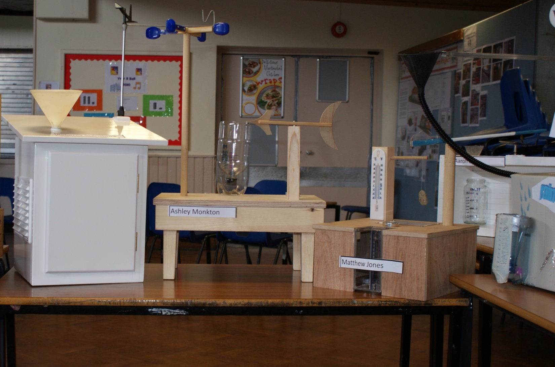
Success Criteria
In order for my homework to be successful I will need to do the following :-
1.
2.
3.
4.
5.

