Slide 1
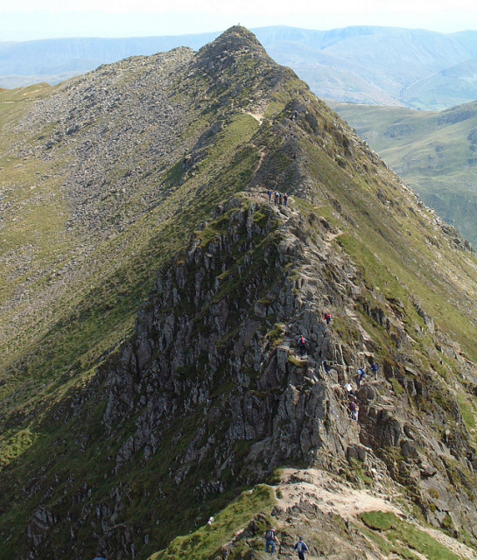
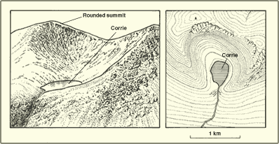
Unit 1 Glaciation
Objective
to identify key Glaciation terminology
to understand key Glaciation terminology
to correctly illustrate each key word
to make a flash card game that works
Task
Your work could be presented as a series of cards
Your work should cover all key terminology for this unit also any additional words that you think are important. You should have at least 10.
The cards must come as a set with 2 cards for each word; one card containing an annotated illustration, the other card the word and definition.
Use colours if possible, you may type the cards if you wish but it is NOT an essential requirement
Remember to make some sort of box or packet for your cards with a title and your name on it
Peer /Self assessment
What did you enjoy most doing this work? What was most challenging? | Now that your work has been marked what do you think you could have improved on?
What do you like most about this piece of work? How do you think this can be improved? | Teacher comments

Slide 2
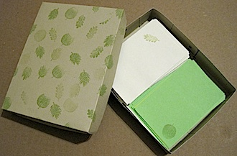
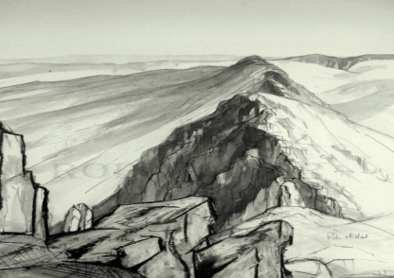
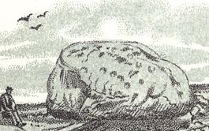
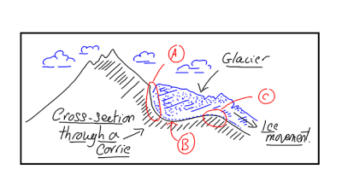
Success Criteria
In order for my homework to be successful I will need to do the following :-
1.
2.
3.
4.
5.
Example
Arête – a sharp narrow ridge found in rugged mountains.
Erratic – a rock or boulder that differs from the surrounding rock and is believed to have been brought from a distance by glacial action.
Corrie – A rounded hollow in a hillside

