Slide 1
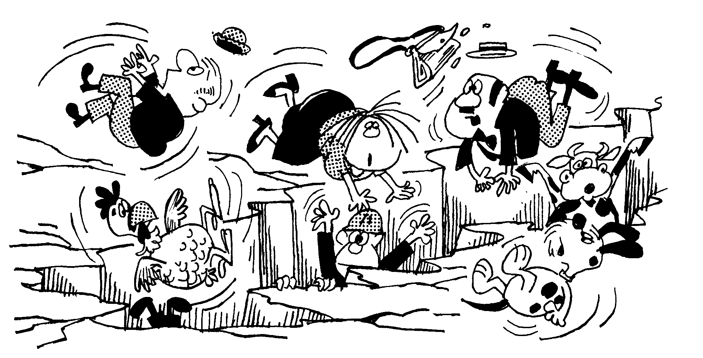
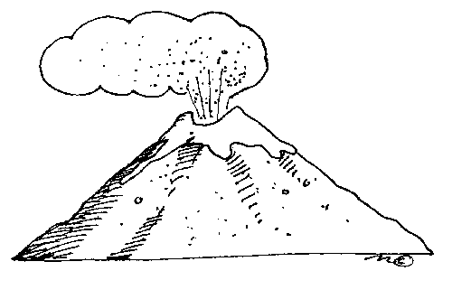
Unit 2 Tectonics: Tectonic Factfile
Objectives
To complete an independent research task/ geographical enquiry
To locate suitable tectonic event s as a case study
To describe the causes and impacts of the tectonic event
To explain the difference in impacts between the tectonic events
Task
You must select two tectonic events. (one LEDC /poor/one MEDC /rich)
You must locate each event and explain what caused the event
You must describe and categorise the impacts of each event (e.g. social-economic-envt)
You must explain how and why the impacts between the events were different
You must present your research information as an A3 display.
Peer/self Assessment
What did you enjoy most doing this work? What was most challenging? | Now that your work has been marked what do you think you could have improved on?
What do you like most about this piece of work? How do you think this can be improved? | Teacher comments

Slide 2
Success Criteria
In order for my homework to be successful I will need to do the following :-
1.
2.
3.
4.
5.

