Slide 1
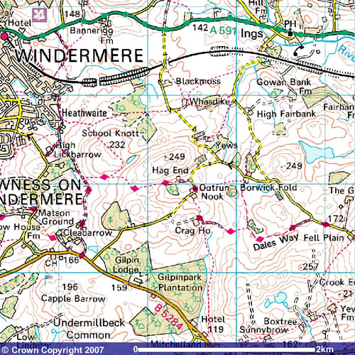
Unit 1 Making connections – My Patch
Objectives
To investigate the physical and human features of your local area.
To communicate your findings clearly using appropriate geographical language and pictures.
Task
To obtain an OS map of the area (16 sq Kms), this is obtainable http://www.ordnancesurvey.co.uk/oswebsite/getamap .Click on the pink circle which says ‘I want to get a map now’.
Show where your location is on a United Kingdom map.
Identify the physical and human features of your area; such as local churches, hills, tourist features etc,
Create a key to explain all the features shown on your OS map.
Find photos (or take them yourself) of all the key features you have identified in point three above.
Display the work on an A3 sheet as shown in the example overleaf.
Peer Assessment
What did you enjoy most doing this work? What was most challenging? | Now that your work has been marked what do you think you could have improved on?
What do you like most about this piece of work? How can this work be improved? | Teacher comments

Slide 2
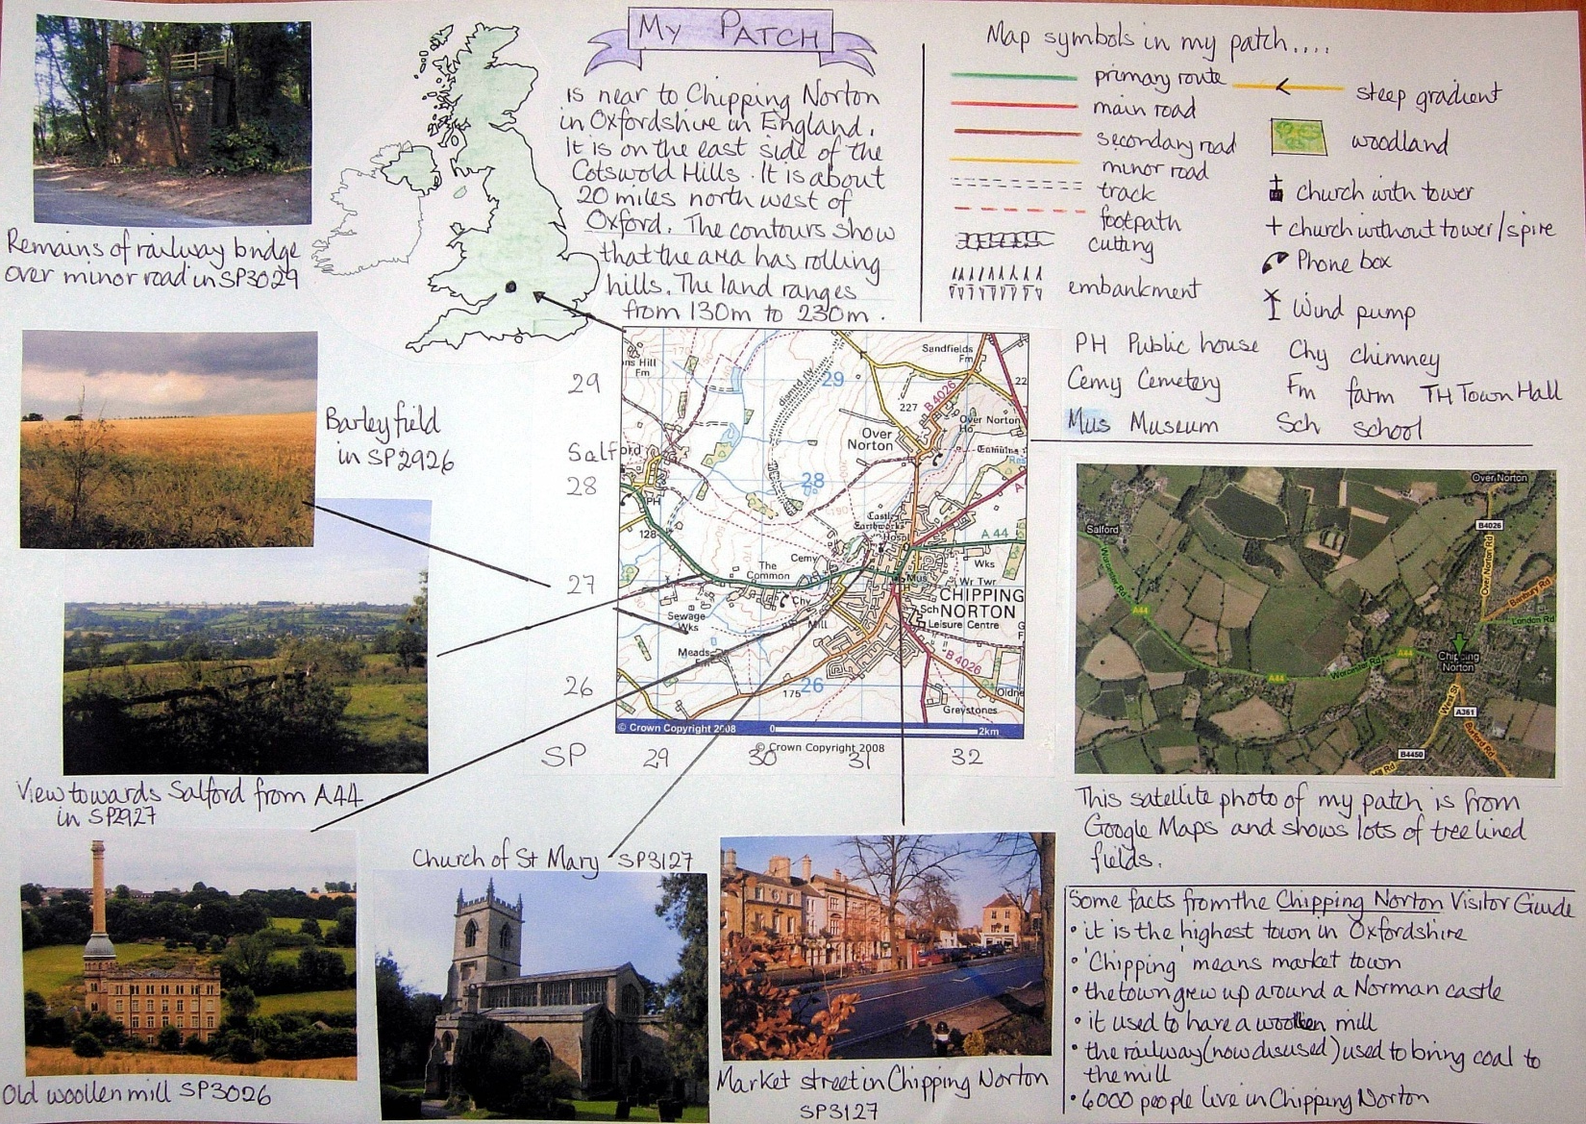
Success Criteria
In order for my homework to be successful I will need to do the following :-
1.
2.
3.
4.
5.
Example for My Patch Homework

