Slide 1
Unit 2 People everywhere – Troutbeck Bridge Fieldwork
Objectives
To identify the steps through which a geographical enquiry progresses.
To describe the changes in the landuse in the Troutbeck Bridge area
To explain the changes which have taken place in the Troutbeck Bridge area.
Task
To complete a fieldwork booklet based on the 3 hypotheses outlined in class.
For each hypothesis complete the aim, method, results and conclusion.
Include appropriate graphs to represent all data collected.
Include any photos and maps which you think are relevant to the fieldwork (location map and photos of the area/ house types).
Complete a cover sheet , introduction and conclusion for the whole project.
Peer/self/teacher Assessment
What did you enjoy most doing this work? What was most challenging? | Now that your work has been marked what do you think you could have improved on?
What do you like most about this piece of work? How can this work be improved? | Teacher comments

Slide 2
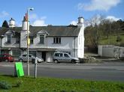
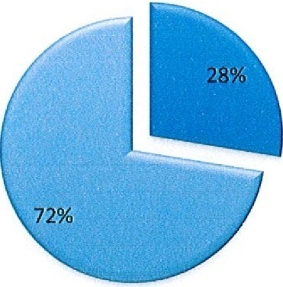
Success Criteria
In order for my homework to be successful I will need to do the following :-
Example of Troutbeck Bridge fieldwork
Hypothesis 2 Troutbeck Bridge has grown most since 1900
Method
I walked around the Troutbeck Bridge area, I stopped to look at the different land uses around the school, looking at houses, recreation and industrial use. Using our identification sheet I was able to identify the different types of housing and when they were built.
Results
I created a land use map to show the different patterns of land use in the area. I constructed a pie chart that represents the proportion of houses that had been before 1900 and after 1900. My pie chart showed that most houses were built after 1900.
A pie chart to show houses built before and after 1900
Before 1900
After 1900
Conclusion
My pie chart shows me that hypothesis 2 is correct and that Troutbeck Bridge has grown most since 1900. I was able to show this after I had counted the number of house built before 1900 and after 1900.

