Slide 1
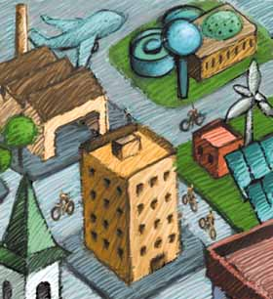
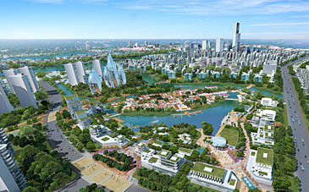
Unit 1 Settlement & Shopping:
Designing a Sustainable City
Objectives
To identify key features of sustainability within an urban area
To describe sustainable schemes within an urban area
To explain how each scheme contributes to sustainability
To communicate your findings clearly using appropriate geographical language and images.
Task
You must create an A3 annotated map/diagram of your sustainable city
You can use a key/labels to identify the different sustainable strategies
You must explain how each part of your city improves sustainability
Consider sustainable approaches to Water-Energy-Technology-Transport-Waste-Biodiversity-Community
Peer /self Assessment
What did you enjoy most doing this work? What was most challenging? | Now that your work has been marked what do you think you could have improved on?
What do you like most about this piece of work? How can this work be improved? | Teacher comments

Slide 2
Success Criteria
In order for my homework to be successful I will need to do the following :-
1.
2.
3.
4.
5.

